Slide 1
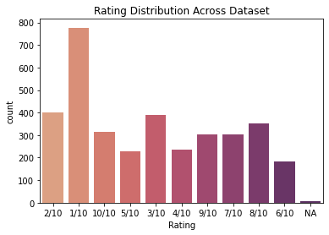
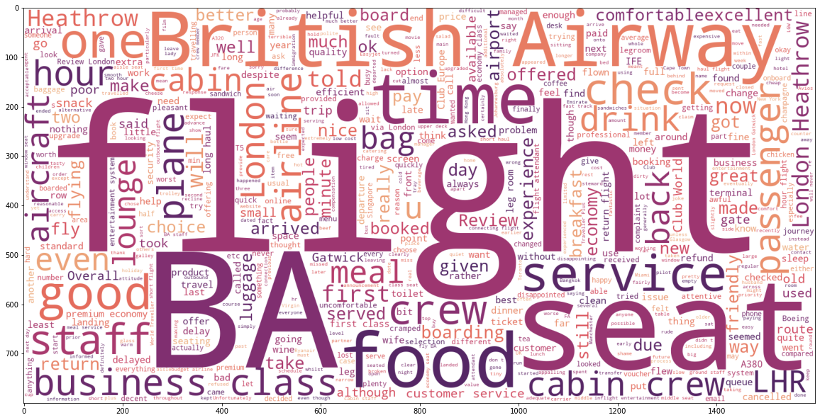
British Airways Customer Reviews
From above visual, we can say that count of ratings for 1 is comparatively much higher than the other rating scores.
Hence, we can say for our data that most of the users are highly dissatisfied with their experience of the overall service of the airlines.
* Flight, Seat, time, business class,food, staff,cabin crew, passenger, & service etc. are most commonly used words in overall reviews by customers.

